Slide 1
Analysis of massive data sets
http://www.fer.hr/predmet/avsp_b
Prof. dr. sc. Siniša Srbljić
Doc. dr. sc. Marin Šilić
Doc. dr. sc. Goran Delač
Doc. dr. sc. Klemo Vladimir
Faculty of Electrical Engineering and Computing
Consumer Computing Laboratory

Slide 2
Analysis of Massive Data Sets:
Finding Similar Items (A)
Marin Šilić

Slide 3
Overview
Motivation
Shingling
MinHashing
Locality Sensitive Hashing

Slide 4
Motivation
Fundamental Data-mining problem
  Examine data for similar items
  Particular notion of similarity – similarity of sets
    Find near-neighbors in “high-dimensional space”
  Examples of finding similar sets
    Collection of Products
    Collection of Images
    Collection of Web Pages

Slide 5


Motivation
Collection of Products
…
Product 1
Product 2
Product 3
Product N
Product 2 and Product 3
share same customer
sets – similar products!
Product 1 and Product 3
don’t share same customer
sets – dissimilar products!
…
User 1
User 2
User 3
User M

Slide 6
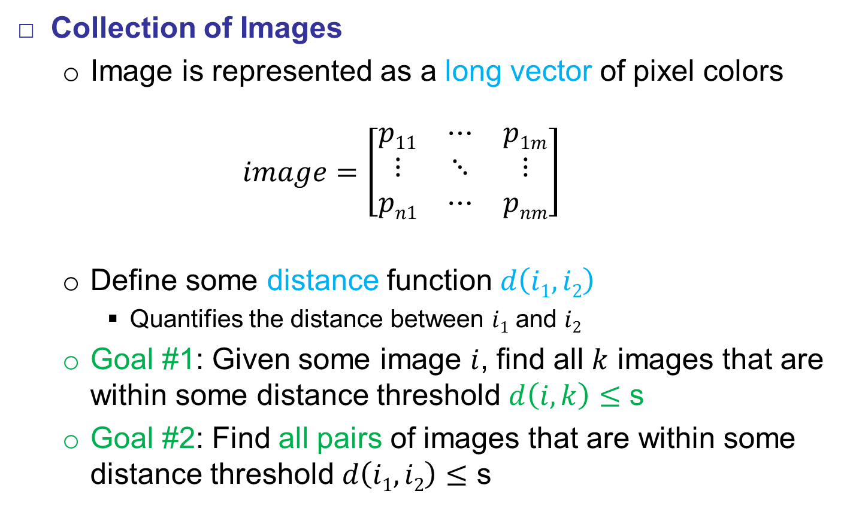
Motivation
Collection of Images
  Image is represented as a long vector of pixel colors
  $$image=\left[\begin{matrix}p11 & ⋯ & p1m \\ ⋮ & ⋱ & ⋮ \\ pn1 & ⋯ & pnm\end{matrix}\right]$$
  Define some distance function $d\left(i1, i2\right)$
    Quantifies the distance between $i1$ and $i2$
  Goal #1: Given some image $i$, find all $k$ images that are within some distance threshold $d\left(i, k\right)≤$ s
  Goal #2: Find all pairs of images that are within some distance threshold $d\left(i1, i2\right)≤$ s

Slide 7
Motivation
Collection of Web Pages
  Finding textually similar documents in a large corpus
    Web Pages
    News Articles
  Testing whether two documents are identical is easy
    Compare character-by-character
  However, documents are not identical
    Share large portion of text
  Appliance
    Plagiarism
    Mirror Pages – don’t show both in search results
    Articles from the Same Source – cluster articles as same stories

Slide 8
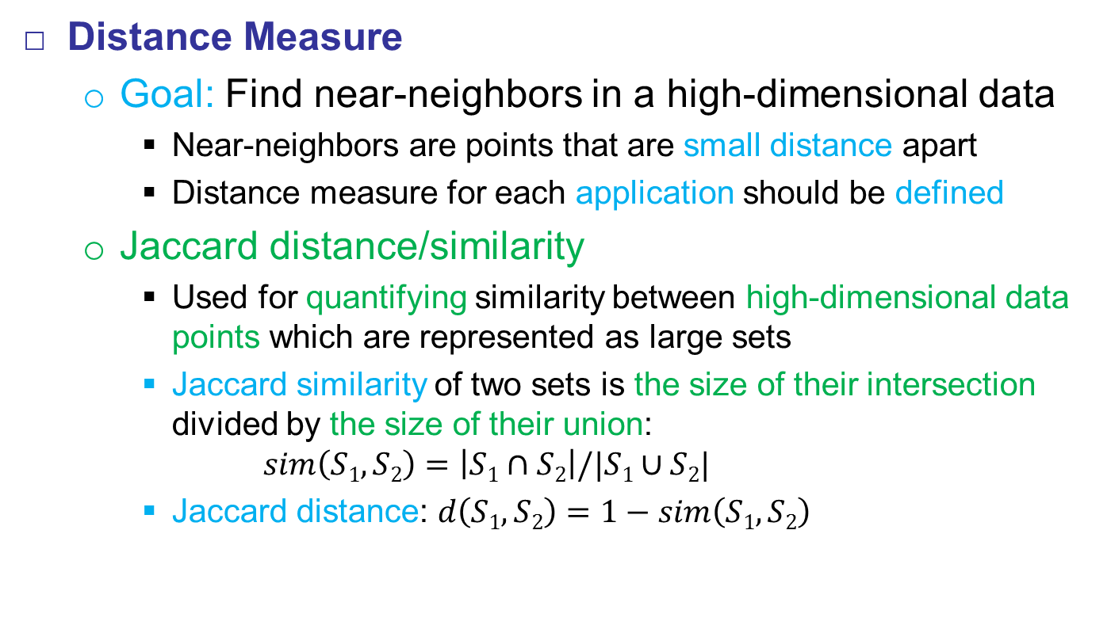
Motivation
Distance Measure
  Goal: Find near-neighbors in a high-dimensional data
    Near-neighbors are points that are small distance apart
    Distance measure for each application should be defined
  Jaccard distance/similarity
    Used for quantifying similarity between high-dimensional data points which are represented as large sets
    Jaccard similarity of two sets is the size of their intersection divided by the size of their union:
    $sim\left(S1, S2\right)=\left|S1∩S2\right|/|S1∪S2|$
    Jaccard distance: $d\left(S1, S2\right)=1−sim\left(S1, S2\right)$

Slide 9

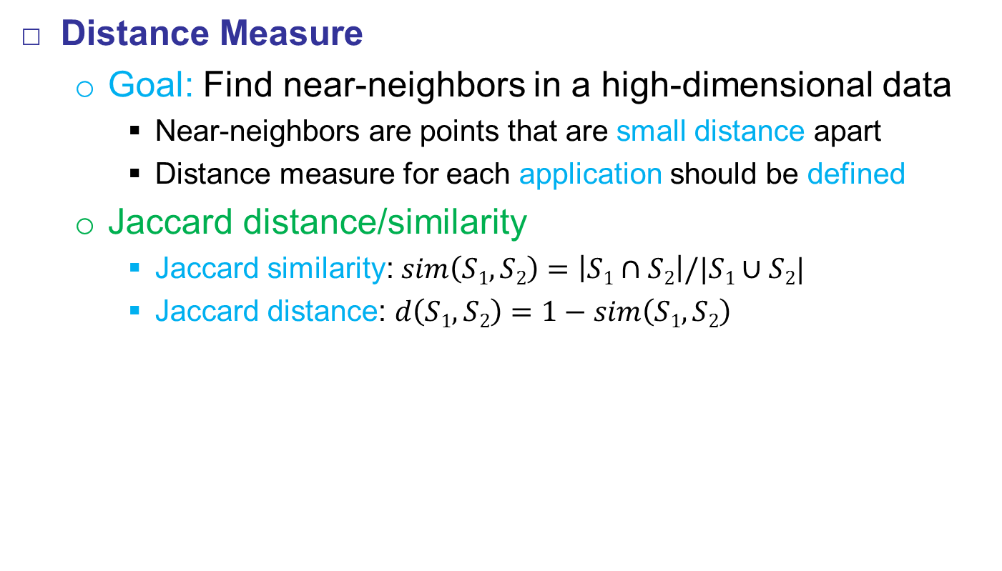

Motivation
Distance Measure
  Goal: Find near-neighbors in a high-dimensional data
    Near-neighbors are points that are small distance apart
    Distance measure for each application should be defined
  Jaccard distance/similarity
    Jaccard similarity:$sim\left(S1, S2\right)=\left|S1∩S2\right|/|S1∪S2|$
    Jaccard distance: $d\left(S1, S2\right)=1−sim\left(S1, S2\right)$
$sim\left(S1, S2\right)$ = 2 / 5
$d\left(S1, S2\right)$ = 3 / 5

Slide 10
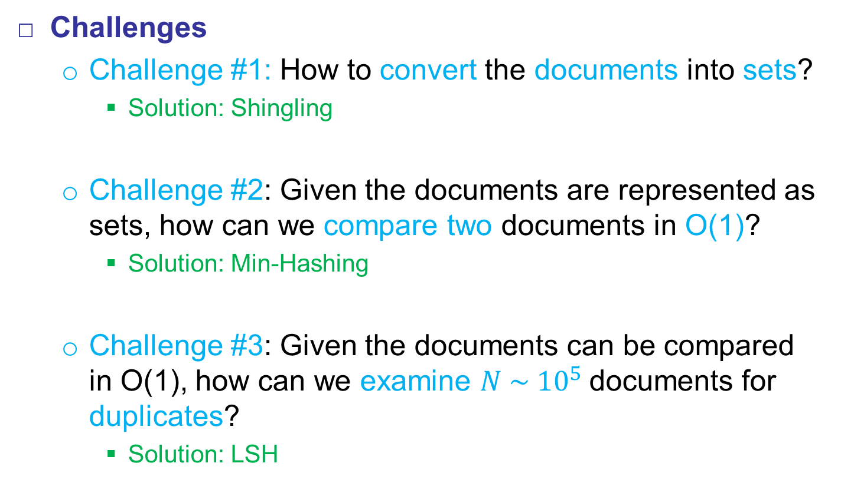
Motivation
Challenges
  Challenge #1: How to convert the documents into sets?
    Solution: Shingling
  Challenge #2: Given the documents are represented as sets, how can we compare two documents in O(1)?
    Solution: Min-Hashing
  Challenge #3: Given the documents can be compared in O(1), how can we examine $N \sim {10}^{5}$documents for duplicates?
    Solution: LSH

Slide 11
Motivation
High-level Overview
Shingling
Min Hashing
Locality-
Sensitive Hashing
Candidate pairs:
Pairs of signatures
worth testing for similarity
Set of documents
For each doc:
The set of strings
of length k that
appear in the doc
For each doc:
Signature: short
integer vector that
represents set and
preserves similarity

Slide 12
Shingling
Challenge #1: Convert documents to sets
  Approaches
    Document = set of words that appear in it
    Document = set of “important” words that appear in it
  We need to have a representation that incorporates the ordering of words
    A different approach should be used – Shingles

Slide 13
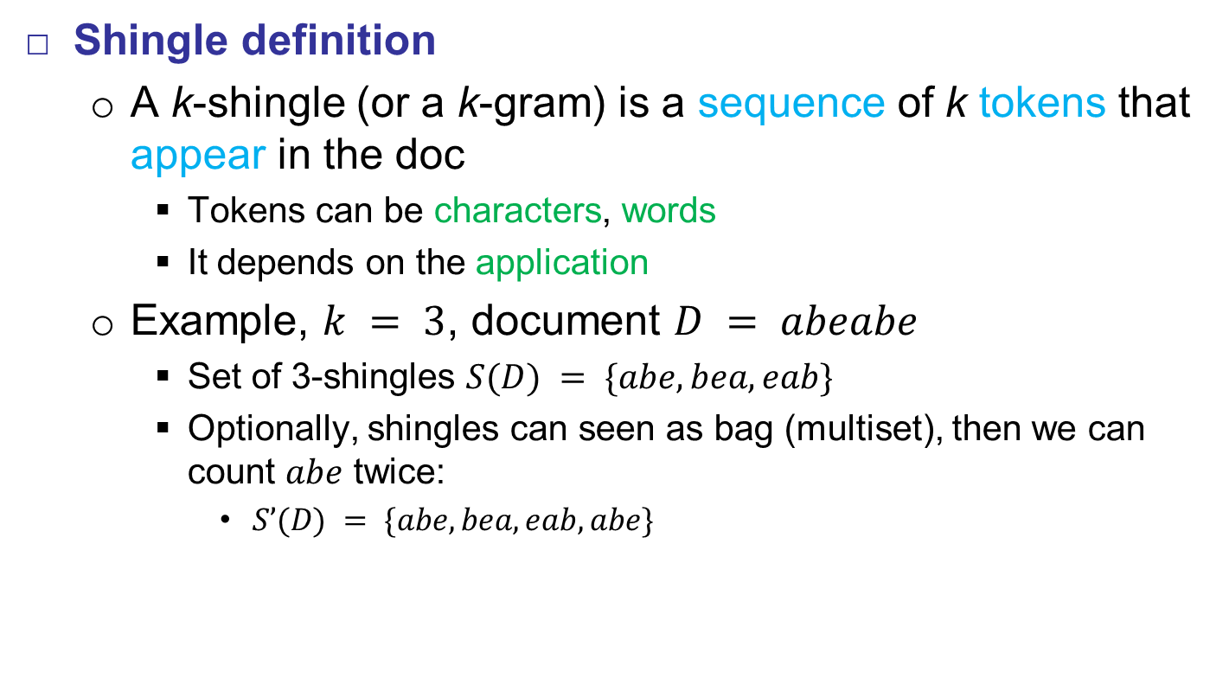
Shingling
Shingle definition
  A k-shingle (or a k-gram) is a sequence of k tokens that appear in the doc
    Tokens can be characters, words
    It depends on the application
  Example, $k = 3$, document $D = abeabe$
    Set of 3-shingles $S(D) = \{abe, bea, eab\}$
    Optionally, shingles can seen as bag (multiset), then we can count $abe$ twice:
      $S’(D) = \{abe, bea, eab, abe\}$

Slide 14
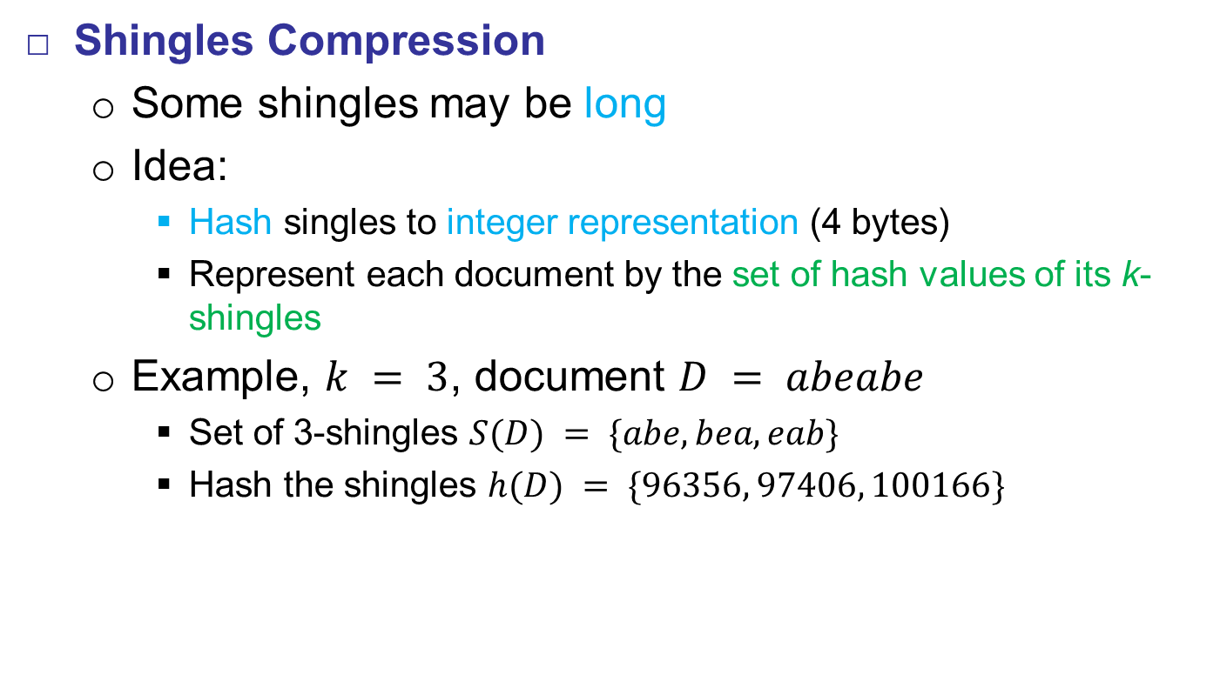
Shingling
Shingles Compression
  Some shingles may be long
  Idea:
    Hash singles to integer representation (4 bytes)
    Represent each document by the set of hash values of its k-shingles
  Example, $k = 3$, document $D = abeabe$
    Set of 3-shingles $S(D) = \{abe, bea, eab\}$
    Hash the shingles $h(D) = \{96356, 97406, 100166\}$

Slide 15
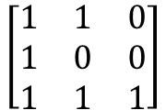
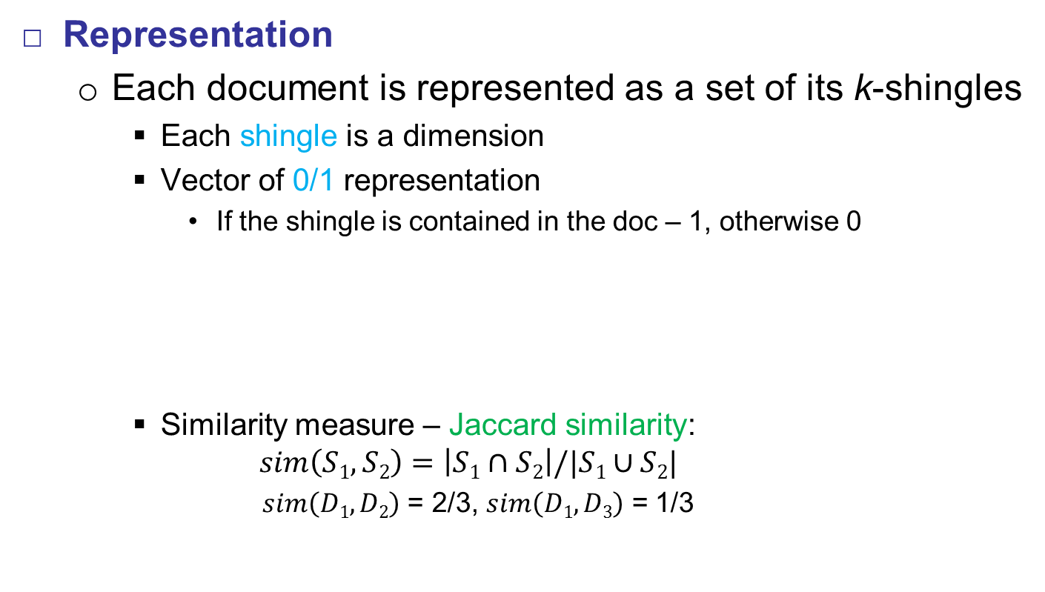
Shingling
Representation
  Each document is represented as a set of its k-shingles
    Each shingle is a dimension
    Vector of 0/1 representation
      If the shingle is contained in the doc – 1, otherwise 0
    Similarity measure – Jaccard similarity:
    $$sim\left(S1, S2\right)=\left|S1∩S2\right|/|S1∪S2|$$
        $sim\left(D1, D2\right)$ = 2/3, $sim\left(D1, D3\right)$ = 1/3
D₁ D₂ D₃
D₁ = abeabe
D₂ = abe eab
D₃ = eab
abe
$$\left[\begin{matrix}1 & 1 & 0 \\ 1 & 0 & 0 \\ 1 & 1 & 1\end{matrix}\right]$$
bea
eab

Slide 16
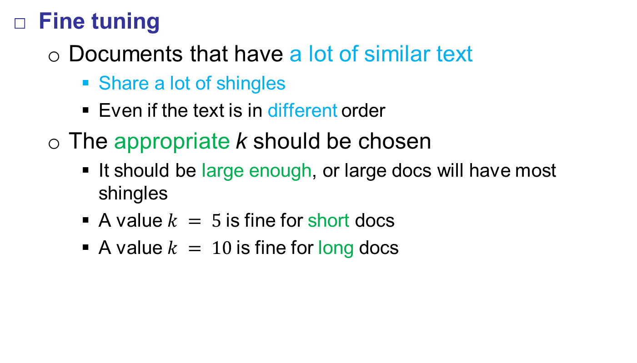
Shingling
Fine tuning
  Documents that have a lot of similar text
    Share a lot of shingles
    Even if the text is in different order
  The appropriate k should be chosen
    It should be large enough, or large docs will have most shingles
    A value $k = 5$is fine for short docs
    A value $k = 10$is fine for long docs

Slide 17
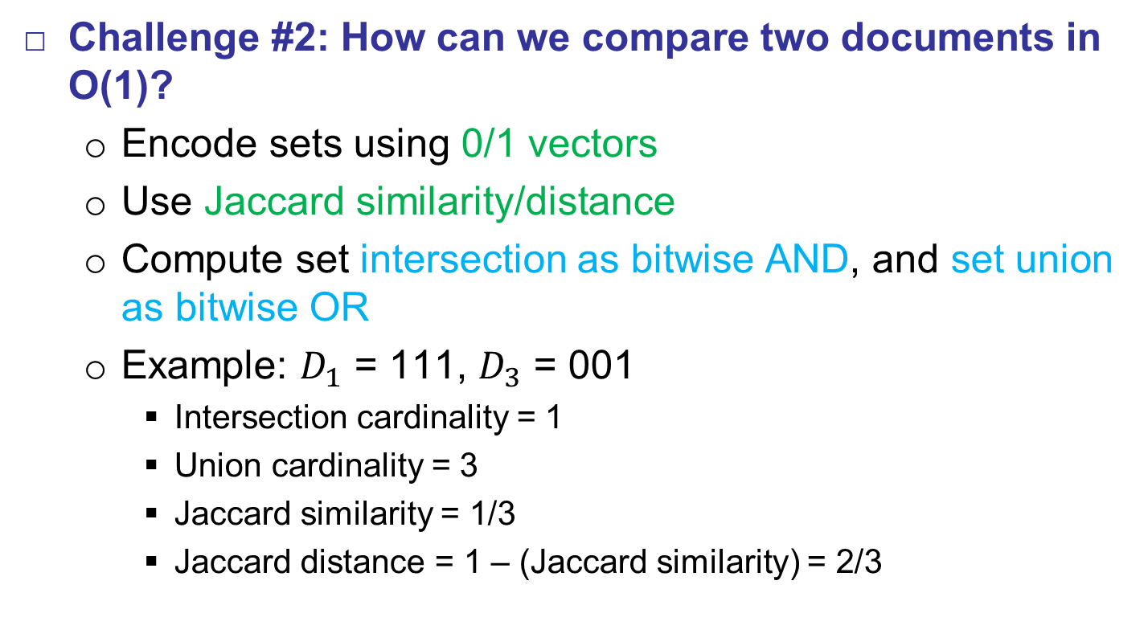
Min-Hashing
Challenge #2: How can we compare two documents in O(1)?
  Encode sets using 0/1 vectors
  Use Jaccard similarity/distance
  Compute set intersection as bitwise AND, and set union as bitwise OR
  Example: $D_{1}$ = 111, $D_{3}$ = 001
    Intersection cardinality = 1
    Union cardinality = 3
    Jaccard similarity = 1/3
    Jaccard distance = 1 – (Jaccard similarity) = 2/3

Slide 18
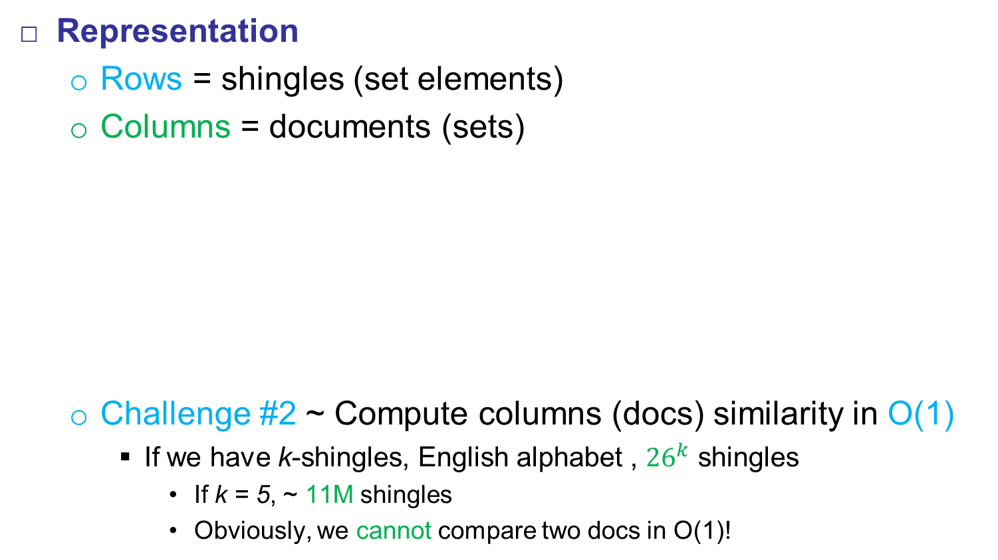
Min-Hashing
Representation
  Rows = shingles (set elements)
  Columns = documents (sets)
  Challenge #2 ~ Compute columns (docs) similarity in O(1)
    If we have k-shingles, English alphabet , ${26}^{k}$ shingles
      If k = 5, ~ 11M shingles
      Obviously, we cannot compare two docs in O(1)!
 | documents
shingles | 1 | 0 | 1 | 1
 | 0 | 0 | 1 | 1
 | 1 | 1 | 0 | 0
 | 0 | 0 | 1 | 1

Slide 19
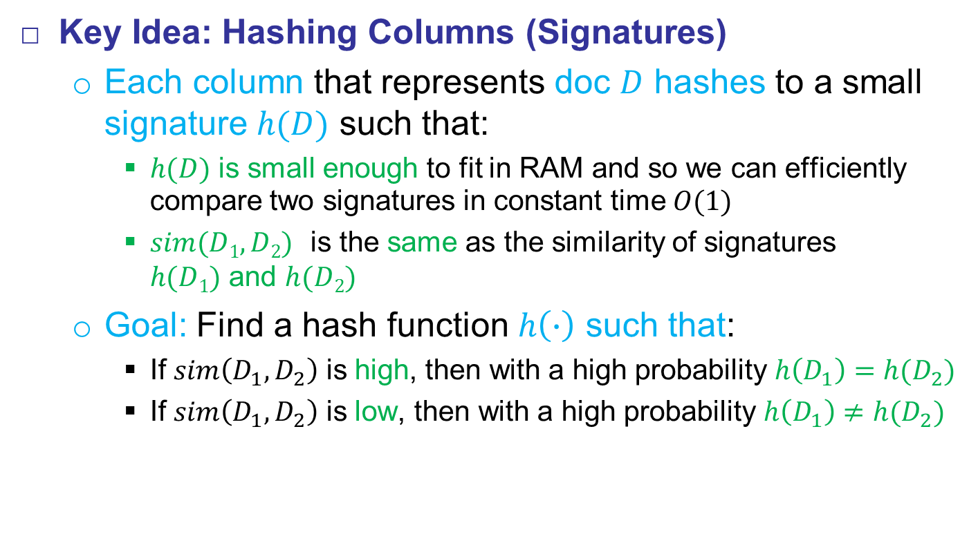
Min-Hashing
Key Idea: Hashing Columns (Signatures)
  Each column that represents doc $D$ hashes to a small signature $h(D)$ such that:
    $h(D)$ is small enough to fit in RAM and so we can efficiently
    compare two signatures in constant time $O(1)$
    $sim(D1, D2)$ is the same as the similarity of signatures
    $h(D1)$ and $h(D2)$
  Goal: Find a hash function $h\left(∙\right)$ such that:
    If $sim\left(D_{1},D_{2}\right)$ is high, then with a high probability $h\left(D_{1}\right)=h(D_{2})$
    If $sim\left(D_{1},D_{2}\right)$ is low, then with a high probability $h\left(D_{1}\right)≠h(D_{2})$

Slide 20
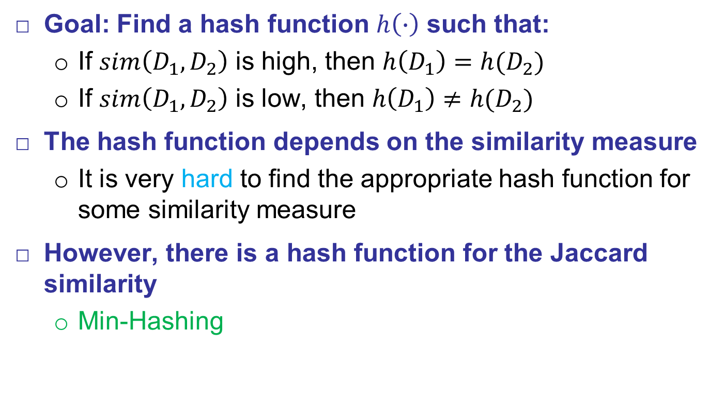
Min-Hashing
Goal: Find a hash function $h\left(∙\right)$ such that:
  If $sim\left(D_{1},D_{2}\right)$ is high, then $h\left(D_{1}\right)=h(D_{2})$
  If $sim\left(D_{1},D_{2}\right)$ is low, then $h\left(D_{1}\right)≠h(D_{2})$
The hash function depends on the similarity measure
  It is very hard to find the appropriate hash function for some similarity measure
However, there is a hash function for the Jaccard similarity
  Min-Hashing

Slide 21
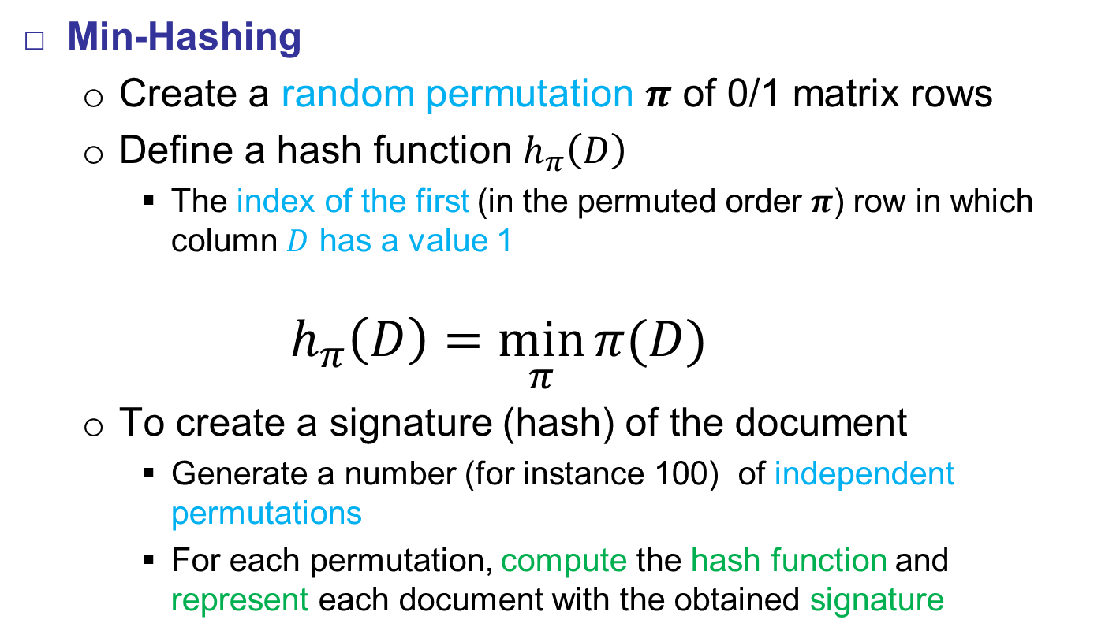
Min-Hashing
Min-Hashing
  Create a random permutation $π$ of 0/1 matrix rows
  Define a hash function $h_{π}\left(D\right)$
    The index of the first (in the permuted order $π$) row in which column $D$ has a value 1
    $$h_{π}\left(D\right)=\min_{π}{π(D)}$$
  To create a signature (hash) of the document
    Generate a number (for instance 100) of independent permutations
    For each permutation, compute the hash function and represent each document with the obtained signature

Slide 22
Min-Hashing
Min-Hashing Example
Permutation
0 | 1 | 3
3 | 5 | 2
4 | 3 | 0
1 | 2 | 5
2 | 4 | 4
5 | 0 | 1
 | Documents
Shingles | 1 | 0 | 1 | 1
 | 0 | 0 | 1 | 1
 | 1 | 1 | 0 | 0
 | 0 | 0 | 1 | 1
 | 0 | 0 | 1 | 0
 | 1 | 1 | 0 | 0
Signatures
0
4
0
0
0
0
1
1
0
0
2
2

Slide 23
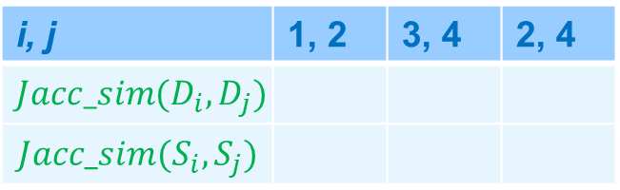
Min-Hashing
Min-Hashing Example
Permutation
0 | 1 | 3
3 | 5 | 2
4 | 3 | 0
1 | 2 | 5
2 | 4 | 4
5 | 0 | 1
 | Documents
Shingles | 1 | 0 | 1 | 1
 | 0 | 0 | 1 | 1
 | 1 | 1 | 0 | 0
 | 0 | 0 | 1 | 1
 | 0 | 0 | 1 | 0
 | 1 | 1 | 0 | 0
Signatures
0
4
0
0
0
0
1
1
0
0
2
2
i, j | 1, 2 | 3, 4 | 2, 4
$$Jacc_sim(D_{i}, D_{j})$$
$$Jacc_sim(S_{i}, S_{j})$$
0.67
0.75
0.0
0.67
1.0
0.0

Slide 24
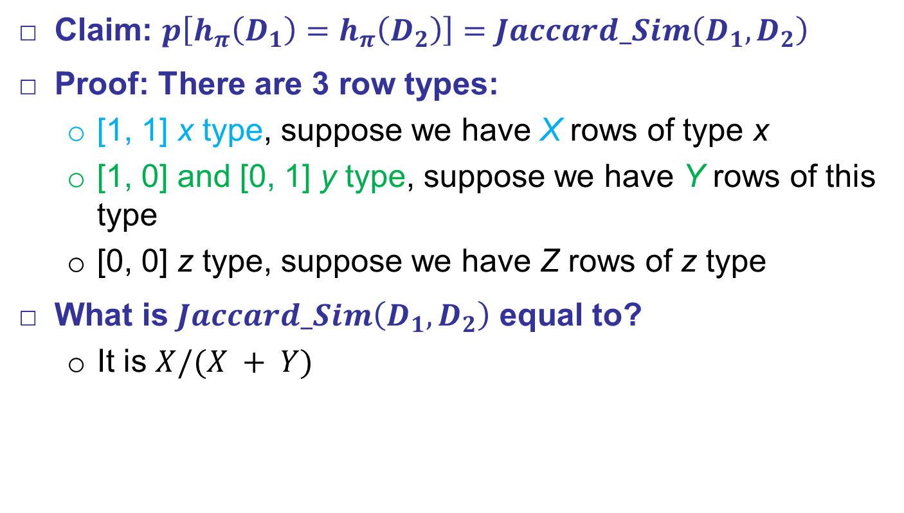
Min-Hashing
Claim: $p\left[h_{π}\left(D_{1}\right)=h_{π}\left(D_{2}\right)\right]=Jaccard_Sim\left(D_{1}, D_{2}\right)$
Proof: There are 3 row types:
  [1, 1] x type, suppose we have X rows of type x
  [1, 0] and [0, 1] y type, suppose we have Y rows of this type
  [0, 0] z type, suppose we have Z rows of z type
What is $Jaccard_Sim\left(D_{1}, D_{2}\right)$ equal to?
  It is $X/(X + Y)$

Slide 25
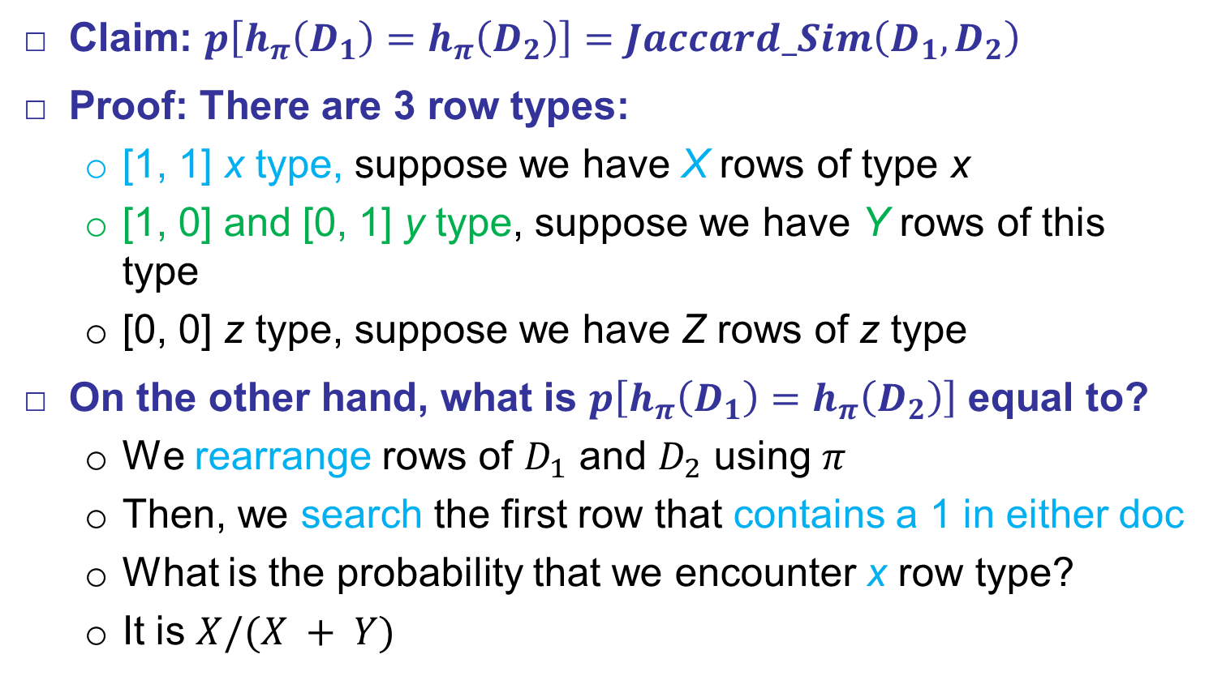
Min-Hashing
Claim: $p\left[h_{π}\left(D_{1}\right)=h_{π}\left(D_{2}\right)\right]=Jaccard_Sim\left(D_{1}, D_{2}\right)$
Proof: There are 3 row types:
  [1, 1] x type, suppose we have X rows of type x
  [1, 0] and [0, 1] y type, suppose we have Y rows of this type
  [0, 0] z type, suppose we have Z rows of z type
On the other hand, what is $p\left[h_{π}\left(D_{1}\right)=h_{π}\left(D_{2}\right)\right]$ equal to?
  We rearrange rows of $D_{1}$ and $D_{2}$ using $π$
  Then, we search the first row that contains a 1 in either doc
  What is the probability that we encounter x row type?
  It is $X/(X + Y)$

Slide 26
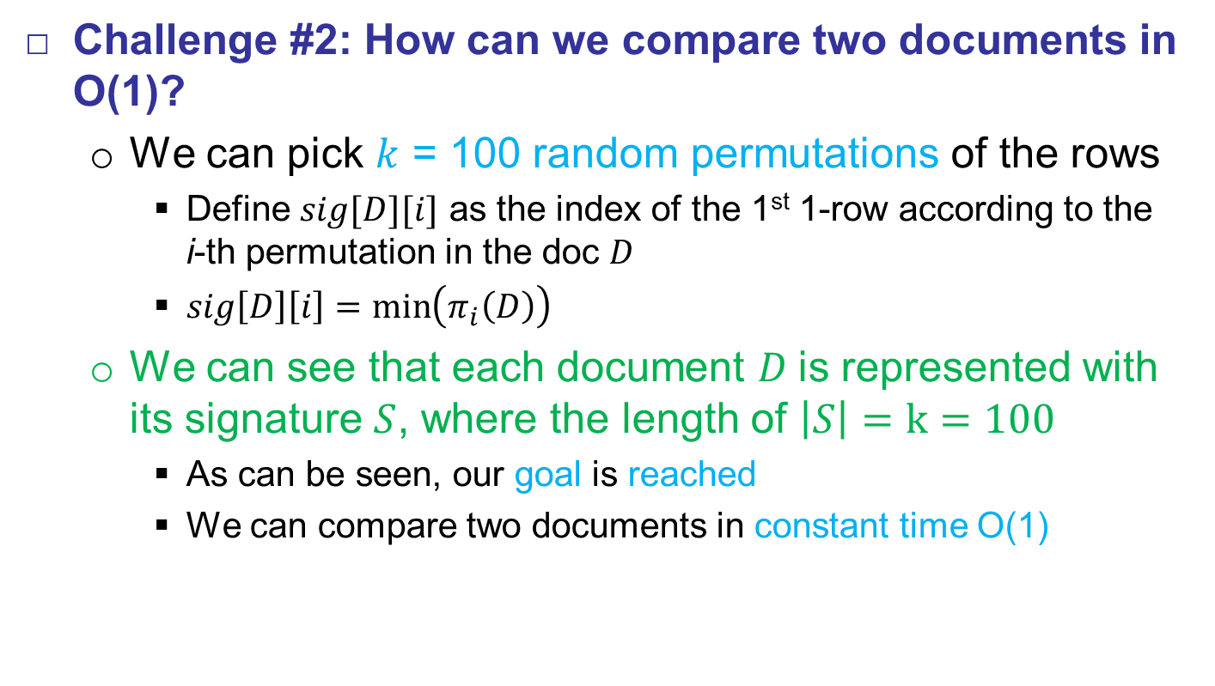
Min-Hashing
Challenge #2: How can we compare two documents in O(1)?
  We can pick $k$ = 100 random permutations of the rows
    Define $sig[D][i]$ as the index of the 1st 1-row according to the
    i-th permutation in the doc $D$
    $sig\left[D\right]\left[i\right]=\min\left(π_{i}\left(D\right)\right)$
  We can see that each document $D$is represented with its signature $S$, where the length of $\left|S\right|=k=100$
    As can be seen, our goal is reached
    We can compare two documents in constant time O(1)

Slide 27
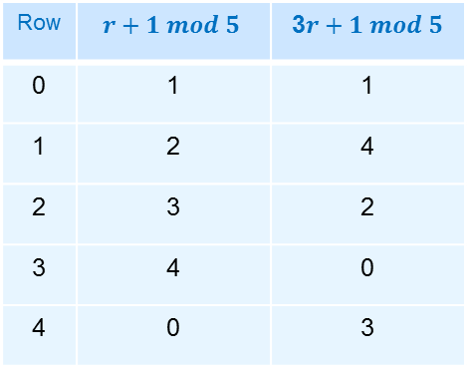
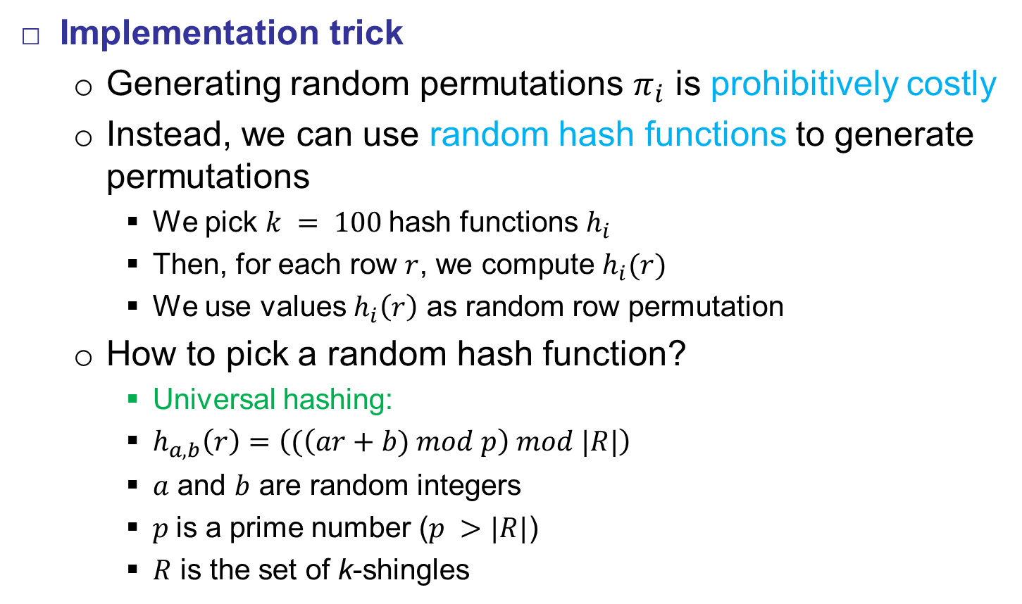
Min-Hashing
Implementation trick
  Generating random permutations $π_{i}$ is prohibitively costly
  Instead, we can use random hash functions to generate permutations
    We pick $k = 100$hash functions $h_{i}$
    Then, for each row $r$, we compute $h_{i}(r)$
    We use values $h_{i}\left(r\right)$ as random row permutation
  How to pick a random hash function?
    Universal hashing:
    $h_{a, b}\left(r\right)=\left((\left(ar+b) mod p\right) mod |R|\right)$
    $a$ and $b$ are random integers
    $p$is a prime number ($p >|R|$)
    $R$ is the set of k-shingles
Row | $$r+1 mod 5$$ | 3$r+1 mod 5$
0 | 1 | 1
1 | 2 | 4
2 | 3 | 2
3 | 4 | 0
4 | 0 | 3

Slide 28
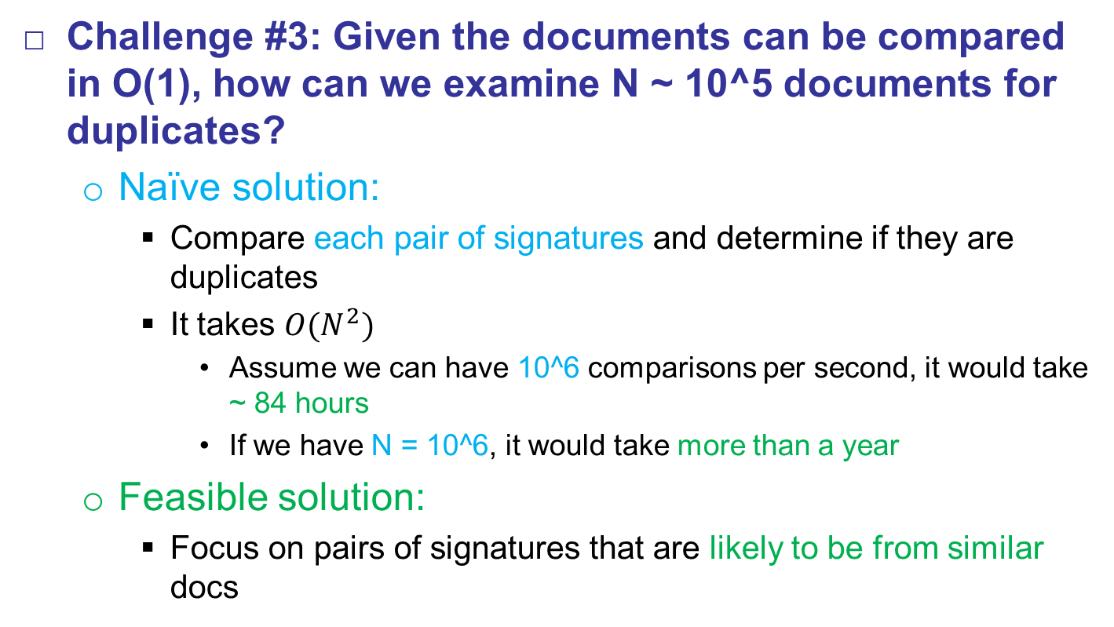
LSH
Challenge #3: Given the documents can be compared in O(1), how can we examine N ~ 10^5 documents for duplicates?
  Naïve solution:
    Compare each pair of signatures and determine if they are duplicates
    It takes $O(N^{2})$
      Assume we can have 10^6 comparisons per second, it would take ~ 84 hours
      If we have N = 10^6, it would take more than a year
  Feasible solution:
    Focus on pairs of signatures that are likely to be from similar docs

Slide 29
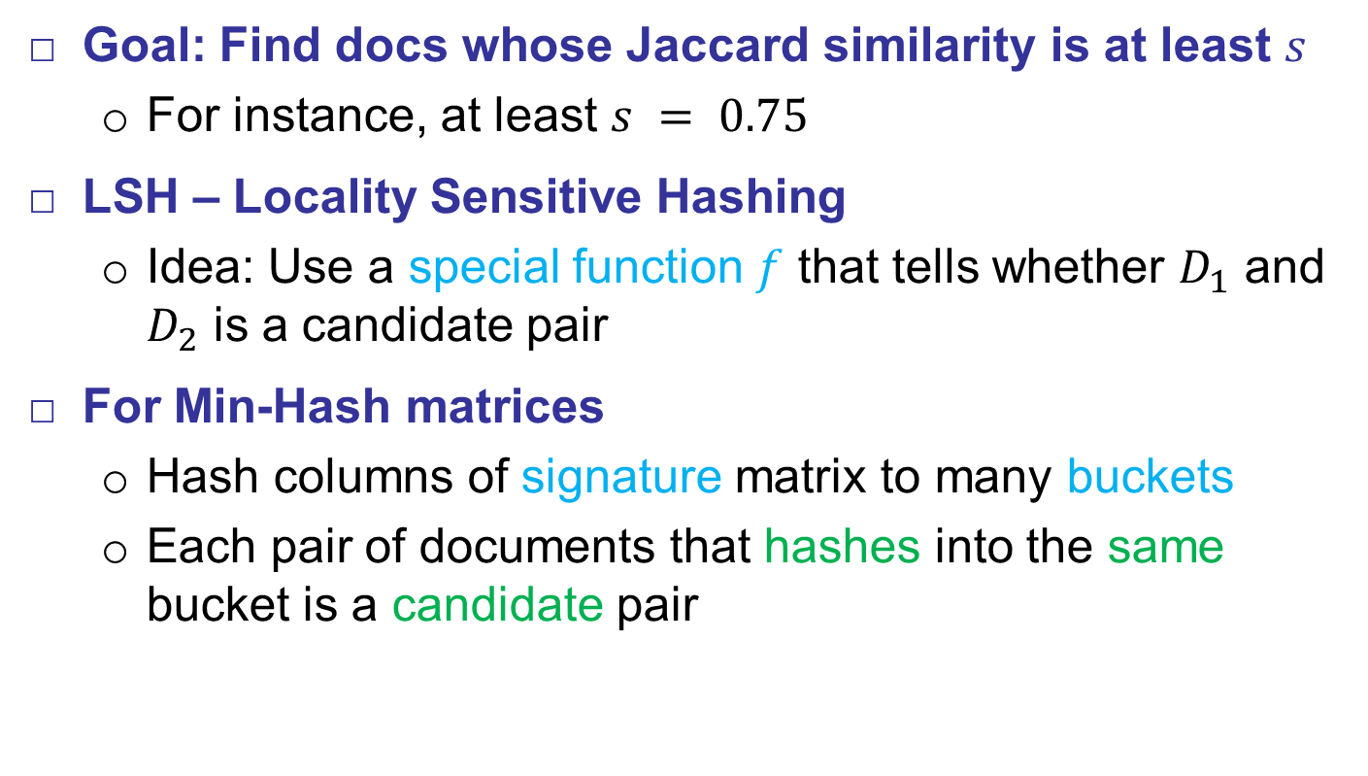
LSH
Goal: Find docs whose Jaccard similarity is at least $s$
  For instance, at least $s = 0.75$
LSH – Locality Sensitive Hashing
  Idea: Use a special function $f$ that tells whether $D_{1}$ and $D_{2}$ is a candidate pair
For Min-Hash matrices
  Hash columns of signature matrix to many buckets
  Each pair of documents that hashes into the same bucket is a candidate pair

Slide 30
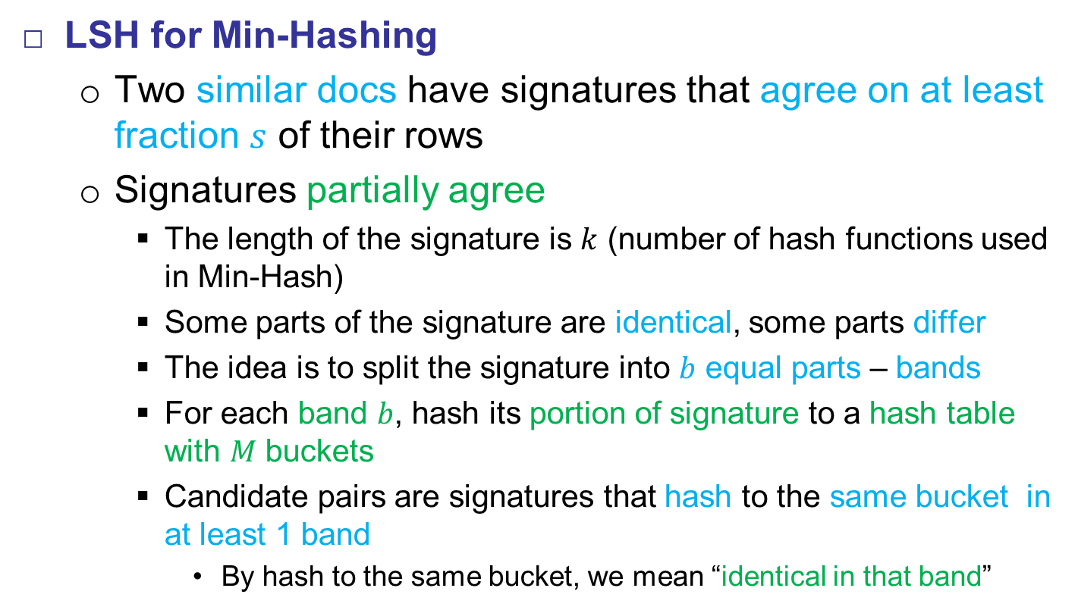
LSH
LSH for Min-Hashing
  Two similar docs have signatures that agree on at least fraction $s$ of their rows
  Signatures partially agree
    The length of the signature is $k$ (number of hash functions used in Min-Hash)
    Some parts of the signature are identical, some parts differ
    The idea is to split the signature into $b$ equal parts – bands
    For each band $b$, hash its portion of signature to a hash table with $M$ buckets
    Candidate pairs are signatures that hash to the same bucket in at least 1 band
      By hash to the same bucket, we mean “identical in that band”

Slide 31
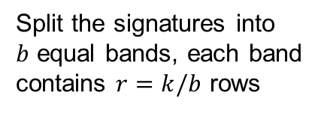
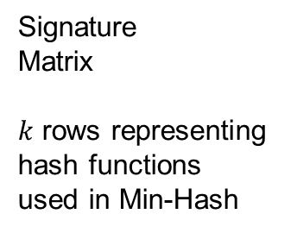
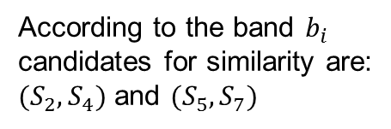


LSH
Hashing Bands
m₀
m₁
m₂
m₃
m₄
m₅
…
m_{m}
$M$ buckets
Signature
Matrix
$k$ rows representing
hash functions
used in Min-Hash
$$b_{i}$$
S₁
S₂
S₃
S₄
S₅
S₆
S₇
S₈
Split the signatures into
$b$ equal bands, each band
contains $r=k/b$ rows
According to the band $b_{i}$
candidates for similarity are:
$(S_{2}, S_{4})$ and $(S_{5}, S_{7})$
Each column is
a doc signature

Slide 32
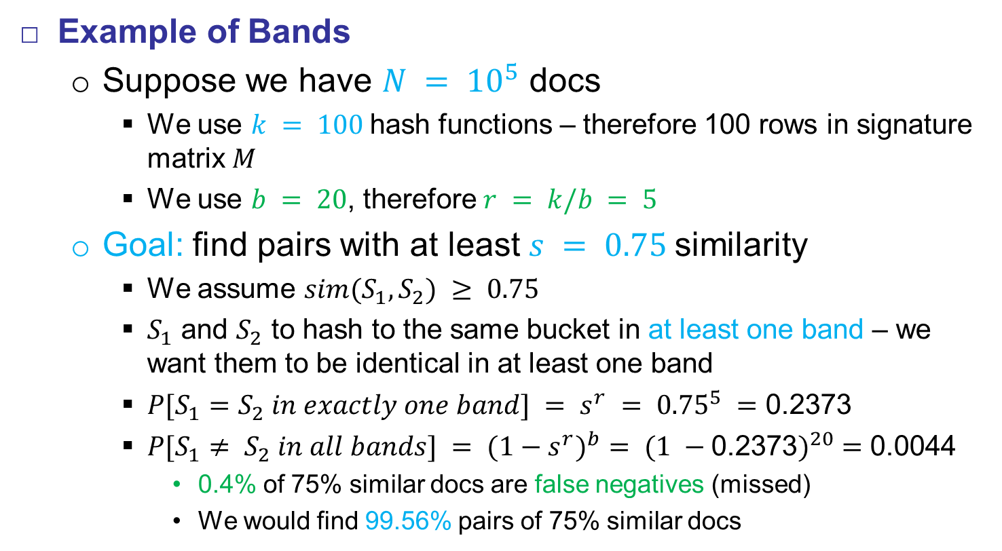
LSH
Example of Bands
  Suppose we have $N = {10}^{5}$ docs
    We use $k = 100$hash functions – therefore 100 rows in signature matrix $M$
    We use $b = 20$, therefore $r = k/b = 5$
  Goal: find pairs with at least $s = 0.75$similarity
    We assume $sim(S_{1}, S_{2}) ≥ 0.75$
    $S_{1}$ and $S_{2}$ to hash to the same bucket in at least one band – we want them to be identical in at least one band
    $P[S_{1}=S_{2} in exactly one band] = s^{r} = {0.75}^{5} =\text{0.2373}$
    $P[S_{1}≠ S_{2} in all bands] = {{(1−s}^{r})}^{b}= {(1 −\text{0.2373})}^{20} =\text{0.0044}$
      0.4% of 75% similar docs are false negatives (missed)
      We would find 99.56% pairs of 75% similar docs

Slide 33
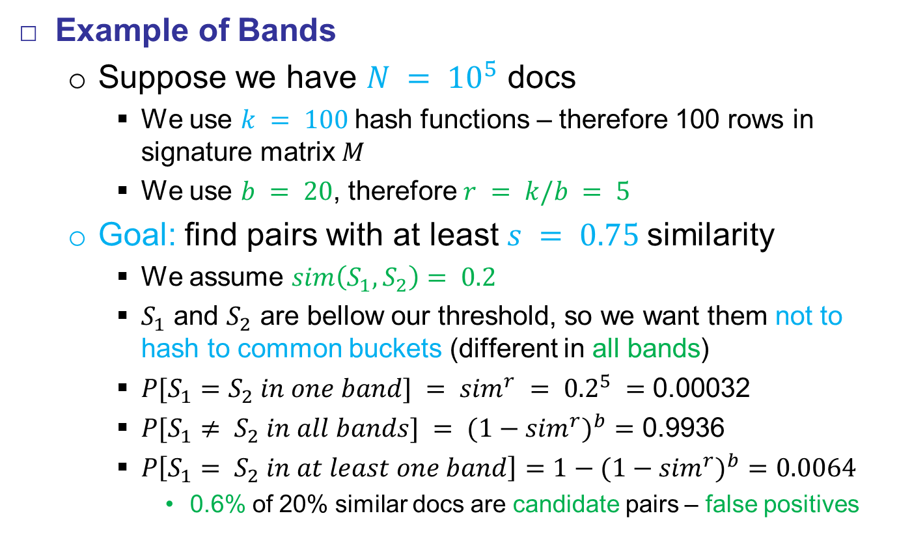
LSH
Example of Bands
  Suppose we have $N = {10}^{5}$ docs
    We use $k = 100$hash functions – therefore 100 rows in signature matrix $M$
    We use $b = 20$, therefore $r = k/b = 5$
  Goal: find pairs with at least $s = 0.75$similarity
    We assume $sim\left(S_{1}, S_{2}\right)= 0.2$
    $S_{1}$ and $S_{2}$ are bellow our threshold, so we want them not to hash to common buckets (different in all bands)
    $P[S_{1}=S_{2} in one band] = {sim}^{r} = {0.2}^{5} =\text{0.0}\text{0032}$
    $P[S_{1}≠ S_{2} in all bands] = {{(1−sim}^{r})}^{b}=$ 0.9936
    $P\left[S_{1}= S_{2} in at least one band\right]=1−{{(1−sim}^{r})}^{b}=0.0064$
      0.6% of 20% similar docs are candidate pairs – false positives

Slide 34
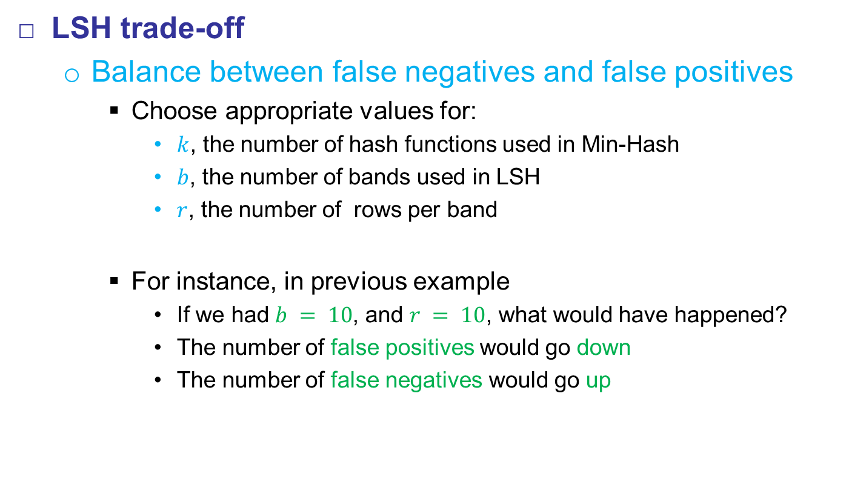
LSH
LSH trade-off
  Balance between false negatives and false positives
    Choose appropriate values for:
      $k$, the number of hash functions used in Min-Hash
      $b$, the number of bands used in LSH
      $r$, the number of rows per band
    For instance, in previous example
      If we had $b = 10$, and $r = 10$, what would have happened?
      The number of false positives would go down
      The number of false negatives would go up

Slide 35
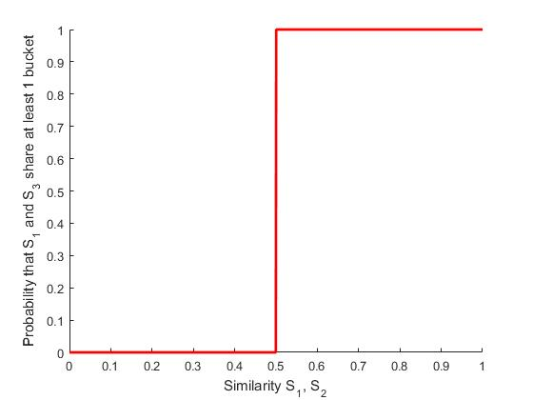
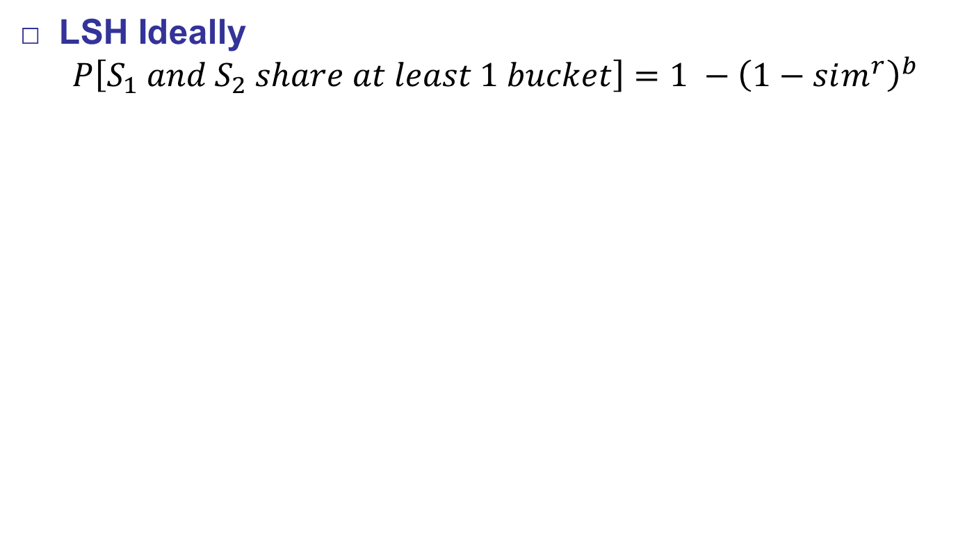
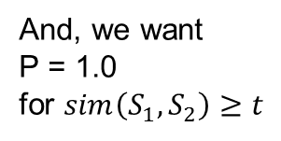

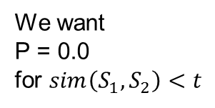
LSH
LSH Ideally
  $$P\left[S_{1} and S_{2} share at least 1 bucket\right]=1 −{\left(1−sim^{r}\right)}^{b}$$
We want
P = 0.0
for $sim\left(S_{1}, S_{2}\right)<t$
And, we want
P = 1.0
for $sim\left(S_{1}, S_{2}\right)≥t$
$t=0.5$, threshold value

Slide 36
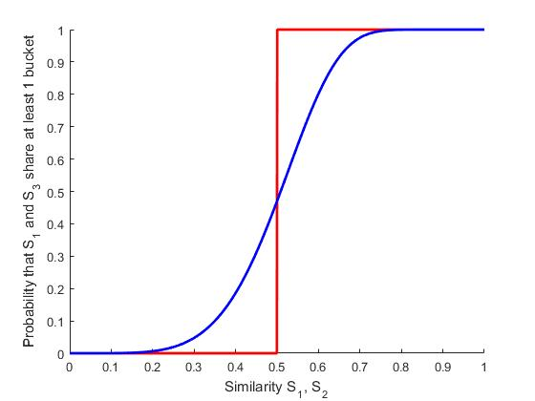
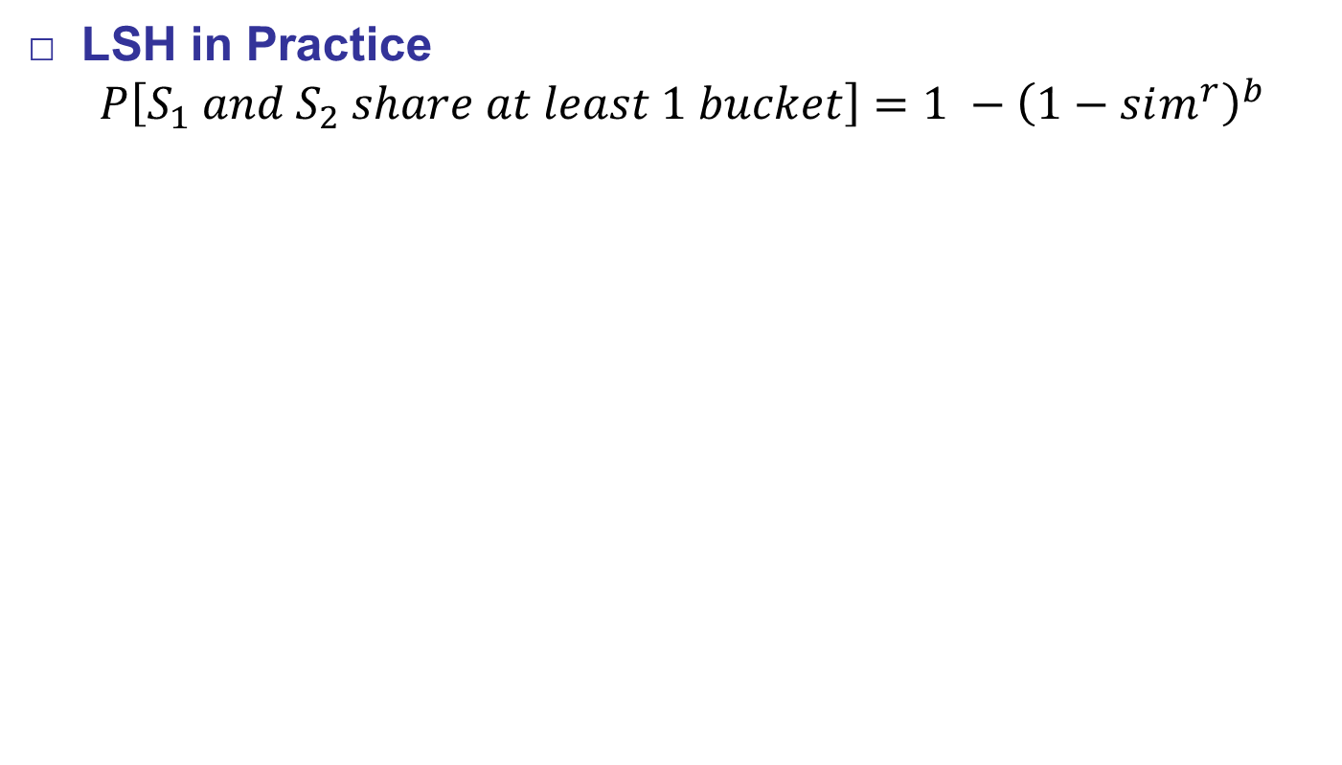
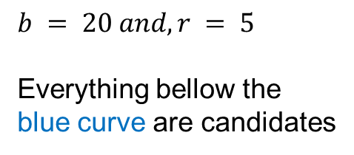
LSH
LSH in Practice
  $$P\left[S_{1} and S_{2} share at least 1 bucket\right]=1 −{\left(1−sim^{r}\right)}^{b}$$
$$b = 20 and, r = 5$$
Everything bellow the
blue curve are candidates

Slide 37
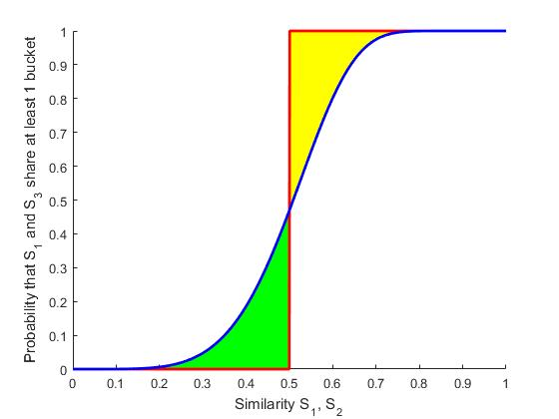
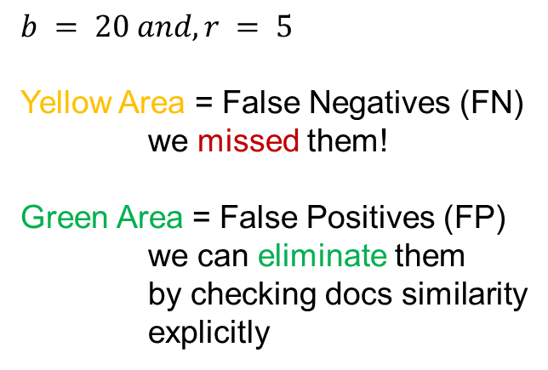
LSH
LSH in Practice
  $$P\left[S_{1} and S_{2} share at least 1 bucket\right]=1 −{\left(1−sim^{r}\right)}^{b}$$
$$b = 20 and, r = 5$$
Yellow Area = False Negatives (FN)
we missed them!
Green Area = False Positives (FP)
we can eliminate them
by checking docs similarity
explicitly

Slide 38
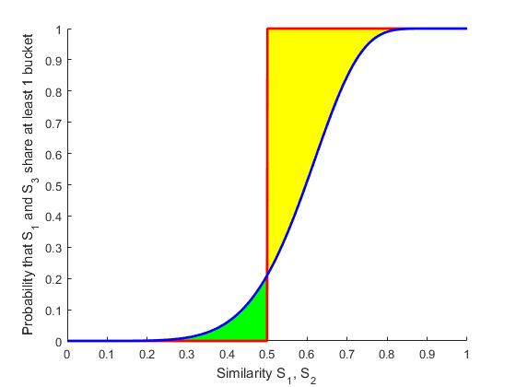

LSH
LSH in Practice
  $$P\left[S_{1} and S_{2} share at least 1 bucket\right]=1 −{\left(1−sim^{r}\right)}^{b}$$
$$b =15 and, r = 5$$
Yellow Area = False Negatives (FN)
we missed them!
Green Area = False Positives (FP)
we can eliminate them
by checking docs similarity
explicitly

Slide 39
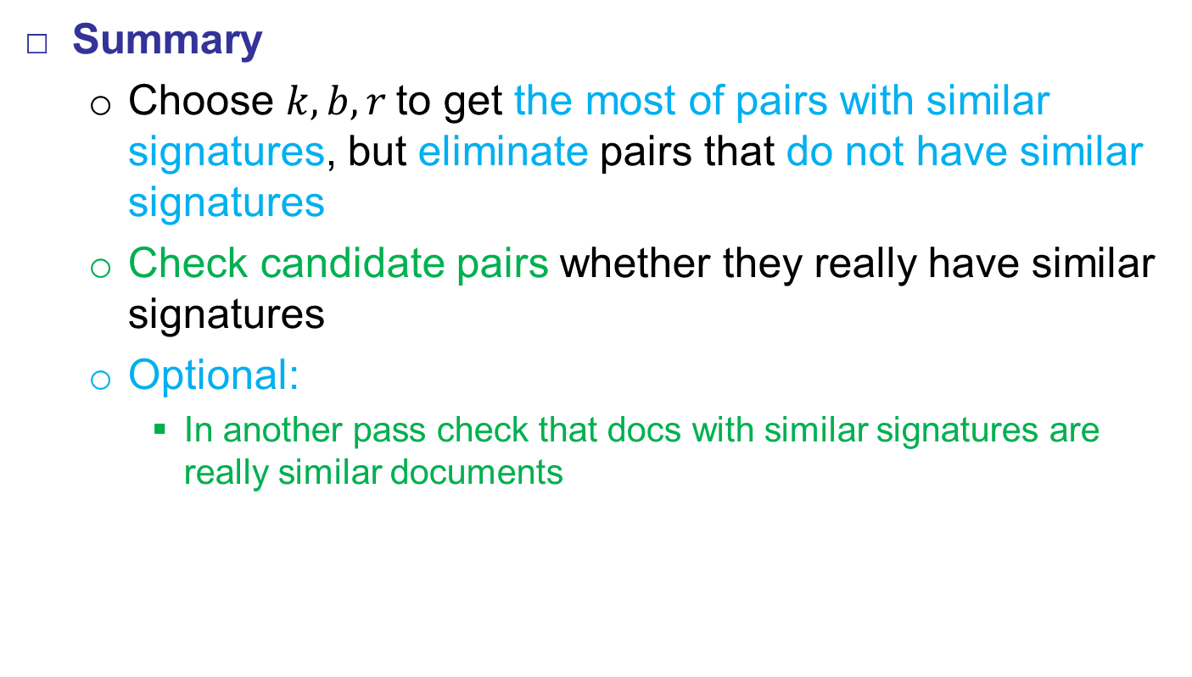
LSH
Summary
  Choose $k, b, r$to get the most of pairs with similar signatures, but eliminate pairs that do not have similar signatures
  Check candidate pairs whether they really have similar signatures
  Optional:
    In another pass check that docs with similar signatures are really similar documents

